Slide 1
Creating and Configuring Web Applications
Notes:
This module discusses the techniques required to create and manage Web Applications. You will learn to configure Web Applications with host headers and alternate access mappings. The module also explains how to control resource usage within a Web Application by creating quotas and adjusting the new SharePoint Foundation thresholds for list throttling. The lecture will conclude with a discussion of configuring a Web Application to allow for anonymous access.

Slide 2
Agenda
Creating New Web Applications
Configuring Web Application
Creating Site Collections
Capacity Planning
Site Collection Security
Multi-tenancy and Site Subscriptions

Slide 3
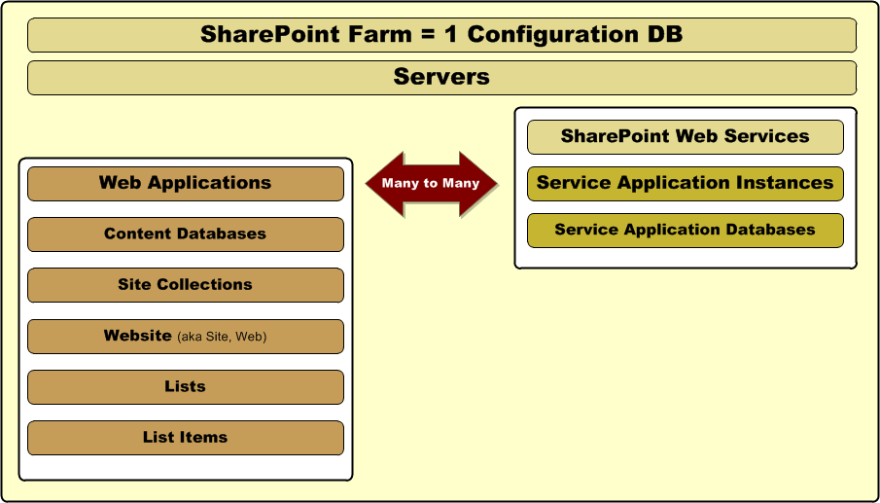
SharePoint Containment Hierarchy
Notes:
You saw this same diagram back in lecture 1 and in lecture 3. However, now we will concentrate what is on the left-hand side which is specific to creating and managing with Web applications.
The Web Application Hierarchy
Each Web application has one or more content databases. However, each content database mustbe associated with one and only one Web application.
Each content database can have multiple site collections. However, each site collection must be associated with one and only one content database .
Each site collections has one or more Websites. However, each Website must be associated with one and only one site collection.
Each Website can have multiple lists. However, each list must be associated with one and only one Website.
Each list can have multiple list items. However, each list item must be associated with one and only one list.

Slide 4
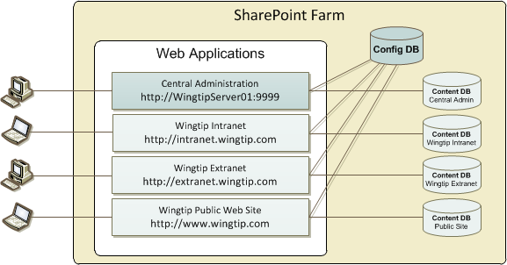
Web Applications
Web Applications provide HTTP entry points
Web applications configured on top of IIS Web sites
Web application provides scope for creating sites
Web application used to configure authentication
Notes:
A Web application is comprised of one or more Internet Information Services (IIS) sites. When you create a new Web application, SharePoint Foundation automatically creates a new content database and defines the authentication method used to connect to the database.

Slide 5
Web Application Creation Information
You need to determine the following
Authentication Method (Claims vs. Classic)
Public URL
Service account used for application pool
Settings for Content Database Creation
Failover Server
Service Application Connections
Notes:
When creating a SharePoint web application you need to determine if you are going to allow users to logon using Windows authentication or using claims.
You can also define a public URL which is a user-friendly URL. This URL needs to be defined in DNS as an A Record before you can use it as public URL for the sites in the web application.
Other important settings are the application pool and the service account that the web application pool is going to use.

Slide 6
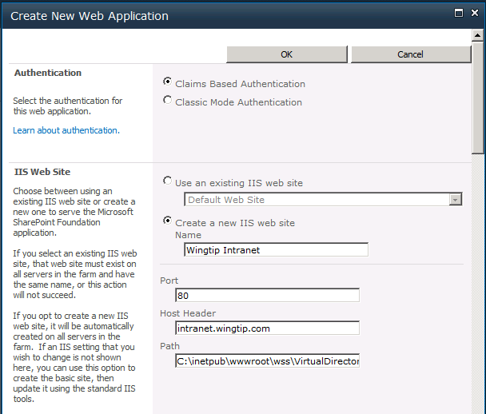
Creating a Web Application (Part 1)
Choose between Classis Mode and Claims
Enter a name for the new IIS Web site
Enter port number and (optionally) host header
Enter path for root directory of IIS Web site
Notes:
Web applications can be created from within the SharePoint Central Administration by navigating to Application Management > Manage web applications. This brings you to a page where all existing web applications are listed. Click the New button on the ribbon to create a new web application.
When creating a web application in the SharePoint Central Administration, the creation page is divided into multiple sections where you have to provide information. The following slides are dedicated to the different sections on this page.
In the Authentication section you can indicate whether you are going to implement the classic authentication method or the claims based method. The classic method allows for Windows authentication.
In the IIS Web Site section you specify information like the port and the host header. The host header is a URL that users will use to navigate to the SharePoint sites hosted by this web application.

Slide 7
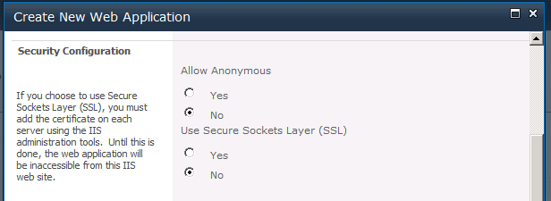
Creating a Web Application (Part 2)
Security Configuration
Select whether to support anonymous access
Select whether to use SSL
Notes:
In the Security Configuration section consists of 3 types of information:
authentication provider: are you going to use NTLM or Kerberos
Allow anonymous access or not
User Secure Sockets Layer (SSL) or not
In the authentication provider part you have to define if you are going to use NTLM or Kerberos.
In the second part you have to specify whether you are going to allow anonymous access or not. By default anonymous access is disabled. This provides an additional layer of security because IIS rejects anonymous access requests before they can ever be processed by SharePoint if anonymous access is disabled. Allowing anonymous access gives users the possibility to view information on the SharePoint sites under the context of the IUSR account.
To ensure confidentiality and integrity of data, it is necessary to encrypt traffic passing between client and server. The mechanism for securing Web sites is Secure Sockets Layer, referred to as SSL. When SSL is enabled on Web sites, users gain access to the Web site by entering URLs that begin with HTTPS, rather than HTTP. If you want to configure Secure Sockets Layer (SSL) you have to install a certificate on each server using the IIS administration tools.

Slide 8
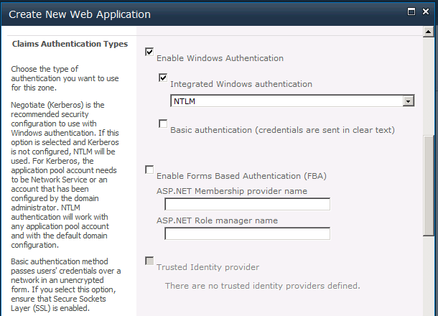
Creating a Web Application (Part 3)
Select authentication types (Claims only)
Windows Authentication
Forms-based Authentication (FBA)
Trusted Identity Providers
Notes:
If you choose Claims Based Authentication in the Authentication section, an additional section is added to the Create new Web Application dialog. In this additional section you are able to configure claims based authentication. You can choose between Windows Authentication, Forms Based authentication and Trusted Identity Provider.
Windows Authentication
Users can access the sites in the web application automatically using the credentials they used to logon their pc into the domain.
Forms Based Authentication
Users are presented with a login form where they need to specify their credentials. This type of authentication is supported by the ASP.NET Membership technique. Using this technique, user information is stored in a data store like for example a SQL Server database. After you create an FBA Web application, additional configuration is required.
Trusted Identity Provider
With claims-based authentication, SharePoint 2010 can make use of other identity providers than Active Directory and ASP.NET Membership. An example of such a provider is Live ID. This authentication is Claims-token based and the user is redirected to a login form for authentication.

Slide 9
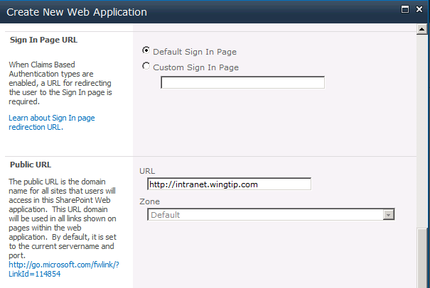
Creating a Web Application (Part 4)
Sign In page URL (Claims only)
Public URL
Notes:
If you choose Claims Based Authentication in the Authentication section, an additional section is added to the Create new Web Application dialog. In this additional section you can opt to use the default Sign In page or a custom sign in page. If you choose for a custom sign in page, you have to specify the URL to that page.
The Public URL section is always available when creating a new web application. A public URL is a user-friendly URL that users will use to access the sites in this SharePoint Web application. It needs to be defined in DNS as an A Record before you can use it as public URL for the sites in the web application.

Slide 10
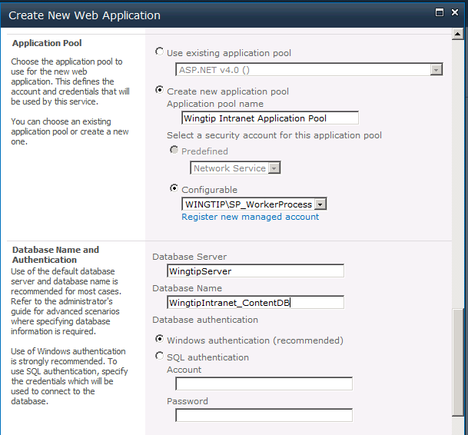
Creating a Web Application (Part 5)
Application Pool
Content Database
Notes:
The other sections on the page are:
Application Pool: here you can decide whether you are going to use an existing application pool ore create a new one. If you decide to create a new application pool, you have to specify a service account for that application pool.
Database name and authentication: this section allows you to specify the name of the content database that will be created for the new web application. You can also specify if you are going to use windows authentication or a specific account to access the content database.
Failover Server: You can choose to associate a database with a specific failover server that is used in conjunction with SQL Server database mirroring.
Search Server: specifies the Search service
Service application connections: By default all service applications that are already configured are listed. But you can also decide to allow the sites of the web application to connect to a specific set of service applications.

Slide 11
DEMO
Creating a New Web Application at http://intranet.wingtip.com

Slide 12
Agenda
Creating New Web Applications
Configuring Web Application
Creating Site Collections
Capacity Planning
Site Collection Security
Multi-tenancy and Site Subscriptions

Slide 13
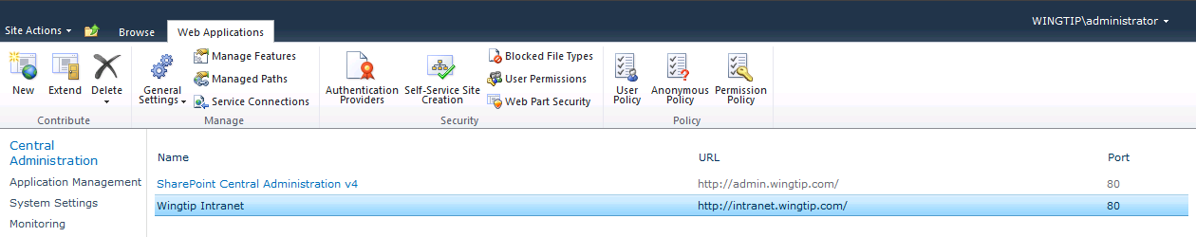
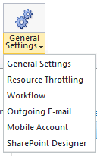
Web Application – General Settings
General Settings
Resource Throttling
Workflow
Outgoing Email
Mobile Account
SharePoint Designer
Notes:
The Web Application management page can be accessed from within the SharePoint Central Administration by navigation to Application Management > Manage web applications. When you select one of the existing web applications listed, a ribbon becomes available from where you can manage the selected web application.
The General Settings button offers the possibility to manage settings for:
Resource throttling
Workflow
Outgoing Email
Mobile Account
SharePoint Designer

Slide 14
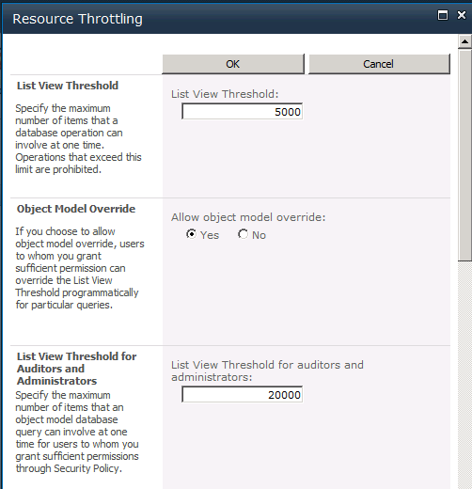
Resource Throttling
SharePoint Foundation introduces list throttling
Prevents users from running expensive queries
Queries fail if result set exceeds predefined thresholds
Default threshold for standard users is 5000 items
Default threshold for site administrator is 20,000 items
Notes:
SharePoint can support lists with lots of data, but the larger the dataset, the bigger burden queries put on the server. List throttling is one of the new features in SharePoint 2010. It enables to set a limit on how much records can be returned when a query is executed.
New controls for admins to block expensive queries: Central Admin offers additional configuration options that can be set per Web application.
Doesn’t help you view more data (doesn’t directly address the “2000 item issue”) but instead more of a heath & monitoring thing.
SharePoint will attempt to execute the query provided.
If query returns records in excess of 5,000 items, it will throw an exception saying it’s too big and it has been throttled.
Thus, SharePoint will ALWAYS try to run the query, but when it exceeds the threshold, it aborts it… even if the real result set would be 5,001 items.
Threshold configurable by Windows PowerShell.

Slide 15
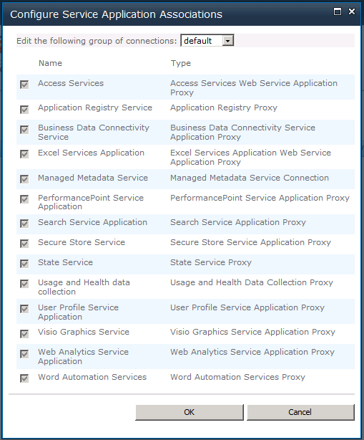
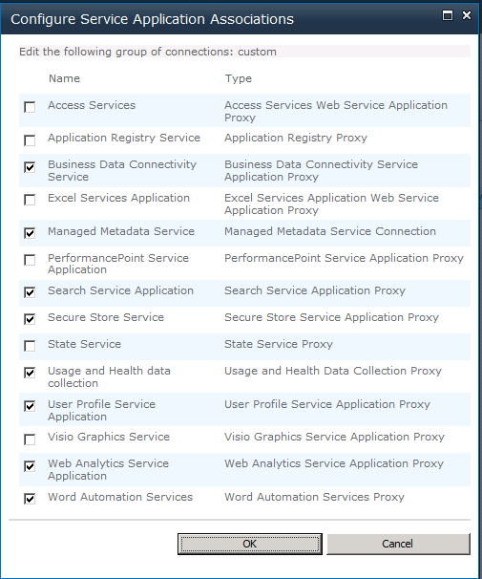
Service Connections
Service connections configured per Web app
Use Default service group or configure custom setup
Notes:
Next to the General Settings button you can find a Service Connection button. It provides you with a list of all service applications instantiated in the farm. By default a web application can connect to all instantiated service applications. You can limit that by selecting custom from the dropdown. That will allow you to select the desired service application instances.

Slide 16
Agenda
Creating New Web Applications
Configuring Web Application
Creating Site Collections
Capacity Planning
Site Collection Security
Multi-tenancy and Site Subscriptions

Slide 17
Creating Site Collections
Why are they important?
Separation of security
Level of ownership
Administration
Can have quotas
Smallest unit for controlling storage database
Notes:
Once the web application is created you can start creating site collections. Each web application can consist of more than one site collection and each web application has a root site collection.
Site collections represent a scope for administrative privileges. You can assign a user as a site collection administrator. That user has full administrative permissions within any existing site and any future site created inside that site collection. To each site collection within the web application you can assign a different user as site collection administrator.
In a large intranet, you need to be able to maintain control over your server resources and carefully monitor areas such as storage space. You must be able to ensure that one site collection cannot use so many resources that other site collections can no longer function. Windows SharePoint Services allows you to specify quota for site collections, so that you can manage your site and server resources.
When a web application is created, it gets its own content database. Within that content database can live one or more site collections. If a site collections grows quickly, it can be moved to a different content database. Sites within a site collection cannot be moved to another content database.

Slide 18
Determine the Following
Title / Description
URL
Template Selection
Choose Specific Template
Custom: <Select template later…>
Primary Site Collection Administrator
Secondary Site Collection Administrator
Quota Template
Notes:
When creating a site collection you are presented with a dialog page similar to the page when creating a web application. It is also divided into sections where you have to provide information .
Title and Description: provide a title for the root site in the site collection and a description.
Web Site Address: specify the URL name and path to create the new site collection
Template Selection: A site template determines what lists and features will be available on your new site. Many aspects of a site can be customized after creation. However, the site template cannot be changed once the site is created.
Primary and Secondary site collection administrator
Quota template: select a predefined quota template to limit resources used for this site collection. The default is no quota limit.

Slide 19
Understanding the Templates
Site Collection is just a container
Templates need to be assigned to the Site Collection
Different SKUs = Different OOTB Templates
Notes:
A site collection is a collection of sites. SharePoint provides site templates in the following categories: collaboration, meetings, and custom. When you create a site collection, you select the template that matches what you want the site to do.

Slide 20
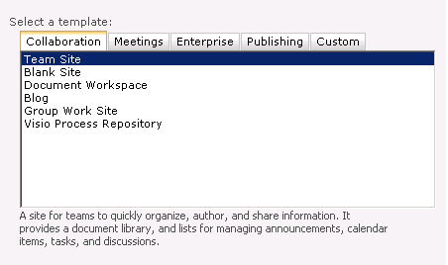
Collaboration Templates
Notes:
The Collaboration tab offers a number of templates like the team site, blank site, document workspace, blog, etc. Each template comes with a number of specific features, document libraries and lists.

Slide 21
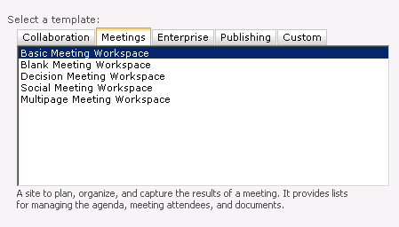
Meetings Templates
Notes:
The Meetings tab offers a number of templates for creating meeting workspaces ranging from basic to multipage workspace template.

Slide 22
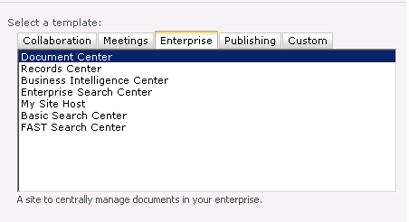
Enterprise Templates
Notes:
The Enterprise tab offers templates for a wide range of centers. Each template offers a different set of features, document libraries and lists.

Slide 23
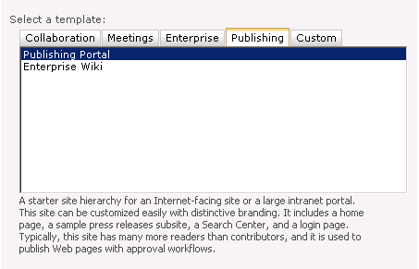
Publishing Templates
Notes:
The Publishing tab contains templates for Internet facing sites that allow for branding and easy customization.

Slide 24
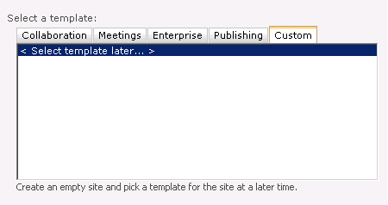
Custom Templates
Notes:
The Custom tab contains not out of the box templates. Custom site templates that are created by developers form within your company or by 3th party will be displayed in this tab.

Slide 25
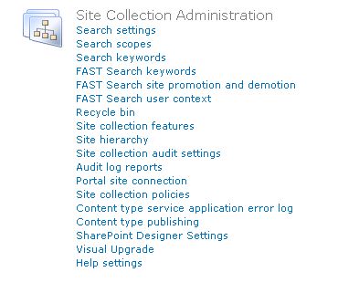
Site Collection Admin Settings
Specific commands that apply to the Site Collection Container
Site Collection Owners are automatically granted access
Notes:
When you navigate to the root site of your site collection you can navigate to the Site Settings page via the Site Actions button on the home page. This Site Settings page contains a number of sections each grouping a number of hyperlinks. The site collection can be managed using the hyperlinks specified under the Site Collection Administration section.
The Site Settings page is security trimmed. Users that have no access to site settings will not have access to this page. Users that have permissions to manage sites, but are not the site collecion administration, will have access to the Site Settings page but will not see the Site Collection Administration section.

Slide 26
DEMO
Creating a New Site Collection

Slide 27
Agenda
Creating New Web Applications
Configuring Web Application
Creating Site Collections
Site Collection Security
Capacity Planning
Multi-tenancy and Site Subscriptions

Slide 28
Managing Content Databases
New Web App = new content database
Web App’s can not share databases
DB is default location of new site collections
To create sites in dedicated DB you can utilize Central Administrator Site, PowerShell or STSADM
Notes:
Careful planning / forward thinking should be considered with regards to DB. One common issue found in the field over and over is implementations that have one single content database which grows to the maximum recommended size (100GB MOSS 2008 – 200GB SP2010) and in a lot of cases well over 1TB. Forward thinking and planning here will save a lot of headache down the road.
For a small organization it may make sense to store everything in a single site collection however at some point the needs and data size may grow. One method to consider is looking at departments that may have a need to be isolated with their own site collection and database. One other method to accomplish this in Central Admin is to create additional databases associated with the web application. This can also be accomplished using PowerShell and STSADM.cmd

Slide 29
Web Application Limits
A Web Application is limited to
300 Content Databases
5 Zones
20 Managed Paths
A Web Server is limited to
10 Application pools
Notes:
A web application is limited to
300 content databases: With 300 content databases per Web application, end user operations such as opening the site or site collections are not affected. But administrative operations such as creating a new site collection will experience decrease in performance. It is recommended to use Windows PowerShell to manage the Web application when a large number of content databases are present, because the management interface becomes slow and difficult to navigate.
5 zones: The number of zones defined for a farm is hard-coded to 5. Zones include Default, Intranet, Extranet, Internet, and custom.
-20 managed paths: Managed paths are cached on the Web server, and CPU resources are used to process incoming requests against the managed path list. Exceeding 20 managed paths per Web application adds more load to the Web server for each request.
A web server is limited to:
10 application pools: The maximum number is determined by hardware capabilities. This limit depends largely upon the amount of RAM allocated to the Web servers.
The workload that the farm is serving, that is, the user base and the usage characteristics (a single highly active application pools can reach 10 GB or more)

Slide 30
Other Size Limitations
A content database is limited to
200 GB of content per content database
100 GB of content per site collection
2 GB of content per file
5,000 site collections per content database
5,000 webs (i.e. sites) per site collection
5,000 items per view
50,000,000 items per list
100,000,000 indexed documents per search index
Notes:
A content database is limited to:
200 GB of content per content database is the recommended maximum size to help ensure system performance. A content database that sizes up to 1 terabyte is supported only for large, single-site repositories and archives with non-collaborative I/O and usage patterns, such as Records Centers. Larger database sizes are supported for these scenarios because their I/O patterns and typical data structure formats have been designed for, and tested at, larger scales.
100 GB of content per site collection: A site collection should not exceed 100 GB unless it is the only site collection in the database.
2 GB of content per file: The default maximum file size is 50 MB. This can be increased up to 2 GB, however a large volume of very large files can affect farm performance.
The maximum number of site collections per content database is 5,000 but 2,000 is the recommendation.
- 5,000 sites per site collection: The maximum recommended number of webs per site collection is 5,000. You can create a very large total number of Web sites by nesting sub sites.
50,000,000 items per list: You can create very large lists using standard views, site hierarchies, and metadata navigation. This value may vary depending on the number of columns in the list and the usage of the list.
100,000,000 indexed documents per search index: You can create very large document libraries by nesting folders, or using standard views and site hierarchy. This value may vary depending on how documents and folders are organized, and by the type and size of documents stored.

Slide 31
Agenda
Creating New Web Applications
Configuring Web Application
Creating Site Collections
Capacity Planning
Site Collection Security
Multi-tenancy and Site Subscriptions

Slide 32
Site Security
Can be broad or granular
Inheriting permissions makes admin life easy
Granted by applying permission levels to groups
Can use AD groups directly
Can use SharePoint Groups
AD groups can be assigned to SP groups
Can assign permissions directly to an AD user
BAD! Management nightmare
Permissions API for Custom Solutions & Reporting
Notes:
Permissions control access to your sites and site content. You can manage permissions by using Microsoft SharePoint Server 2010 groups, which control membership, and fine-grained permissions, which help to secure content at the item and document level. This section describes permissions for sites and site content and provides considerations for choosing permissions.
Inheriting permissions is the default behavior and is the easiest way to manage a group of Web sites. However, sub sites can have their own specific set of permissions.
You can also edit the permissions at document library level, which breaks the inheritance from the site. However, the inheritance is broken only for the specific securable object for which you changed permissions; the rest of the site's permissions are unchanged. You can resume inheriting permissions from the parent list or site at any time.
If you are using fine-grained permissions, you should use groups to avoid having to track individual user accounts. For example, because people move in and out of teams and change responsibilities frequently, tracking those changes and updating the permissions for uniquely secured objects would be time-consuming and error-prone. These groups can be SharePoint groups as well as Active Directory groups.

Slide 33
SharePoint Groups
Three Main Groups
Owners – Full Control
Members – Add / Edit / Delete
Visitors – Read Only
Don’t modify existing groups! Create new groups instead.
Notes:
When a site is created there are three main groups defined.
The Owners group has Full Control permissions. This permission level contains all permissions. This permission level cannot be customized or deleted.
The Members group can add, edit, and delete items in existing lists and document libraries. This permission level is also called the Contributor permissions set.
Visitors group has read only permissions. Users and SharePoint groups with this permission level can view items and pages, open items, and documents.
You can add users to these groups. If you need groups with specific permissions that differ from the three default groups, you better create new groups instead of modifying the default groups.

Slide 34
DEMO
Assigning Permissions

Slide 35
Agenda
Creating New Web Applications
Configuring Web Application
Creating Site Collections
Site Collection Security
Capacity Planning
Multi-tenancy and Site Subscriptions

Slide 36
Multi-Tenancy Defined
Hosting
A unique deployment for each customer on a shared set of resources
Scenarios include:
“Traditional” Web Hosting Environments
SharePoint Online
Corporate On Premise Deployments
Notes:
Multi-tenancy is the isolation of data, operational services and management.
Hosting – think of companies such as RackSpace that offer Hosting to customers for their SharePoint Portal without the burden of hosting it internally.
Think about the Flat/Apartment Building analogy
▪Multiple tenants share same infrastructure (the building, the doors)
▪Some services are shared but have no data (entry phone, refuse collection)
▪Some services are shared (electricity, phone) but data is partitioned (meter readings, billing)
▪Some shared services are a free for all (car parking)
SharePoint 2010 comes with some new features to support hosting environments. The core multi-tenant infrastructure is not turned on by default. It requires a custom service application to be provisioned, and once that's done you can begin configuring the different pieces of multi tenancy:
Multi tenant administration sites
Multi tenant member sites
Feature packs

Slide 37
Summary
Creating New Web Applications
Configuring Web Application
Creating Site Collections
Site Collection Security
Capacity Planning
Multi-tenancy and Site Subscriptions

